Slide 1
Processing of Scalar Implicatures and the Question Under Discussion
Replication of Degen 2013 Experiment 2a
Leyla Kursat

Slide 2
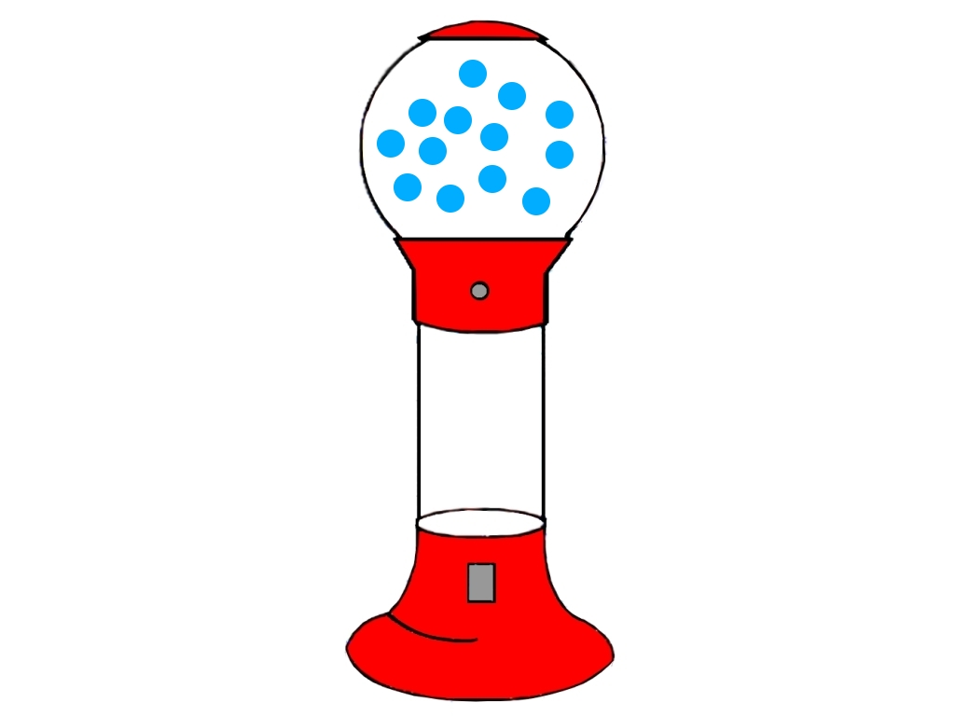
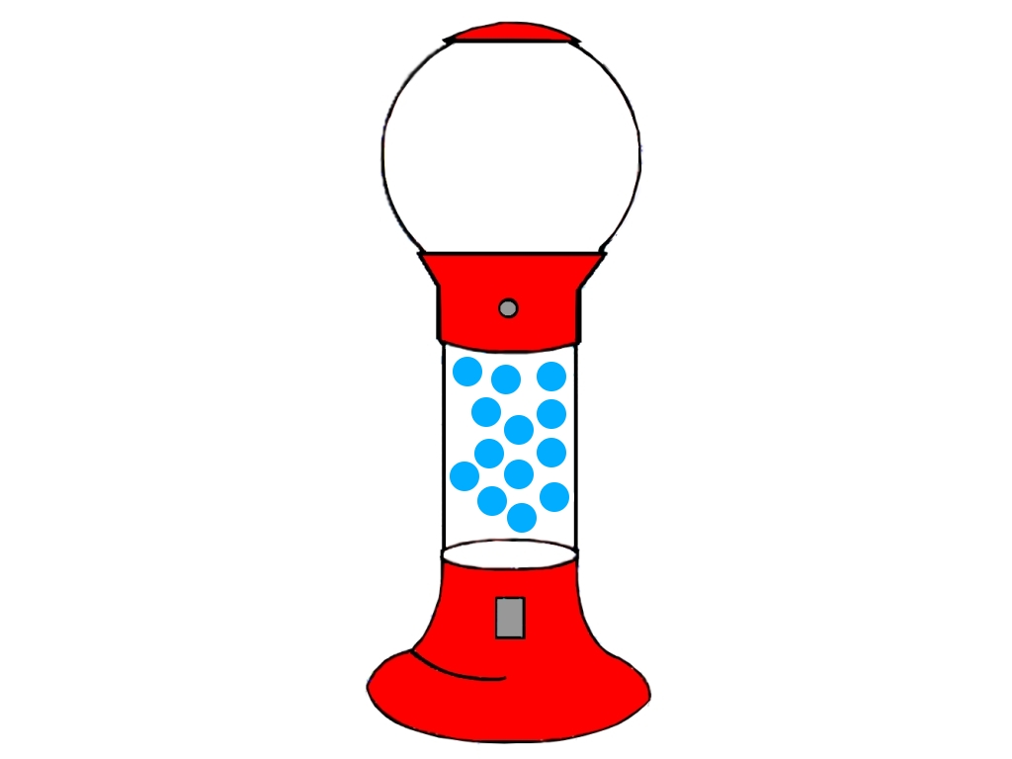
Motivation
Degen 2013 Experiment 2: semantic vs pragmatic processing of the quantifier “some”
“You got some of the gumballs”
Notes:
In her dissertation, Judith used a gumball paradigm to explore the semantic vs pragmatic processing of the quantifier “some”.
I will show you how this paradigm works in a bit, but simply
She showed participants a gumball machine with different number of gumballs in the upper chamber. After a brief delay, some of the gumballs dropped to the lower chamber and participants heard a statement like “You got 5 gumballs” or “You got some gumballs” and were asked to respond by pressing one of two buttons to indicate that yes, they agree with, or no, they disagree with the spoken description.
One focus of these experiments was the response pattern to trials in which all thirteen of the gumballs dropped to the lower chamber, and participants heard “You got some of the gumballs”.
If participants agreed with this statement, drawing the inference from some to all, these responses were considered semantic responses.
If participants disagreed with this statement, drawing the inference from some to some, but not all, these responses were considered pragmatic responses.

Slide 3
Motivation
Degen 2013 Experiment 2: semantic vs pragmatic processing of the quantifier “some”
semantic responses faster than pragmatic responses
in line with previous research
Bott and Noveck , 2014: two alternative forced choice task: pragmatic implicature is computed slower than semantic
Notes:
In Bott and Noveck’s sentence verification paradigm participants were asked to perform a two alternative forced choice task. Participants were asked to respond true or false to clearly true, clearly false, and underinformative items (e.g., Some elephants have trunks). Bott and Noveck found that: a) pragmatic responses reflecting the implicature were slower than semantic responses; and b) pragmatic responses were slower than true responses to alla for the unpartitioned set

Slide 4
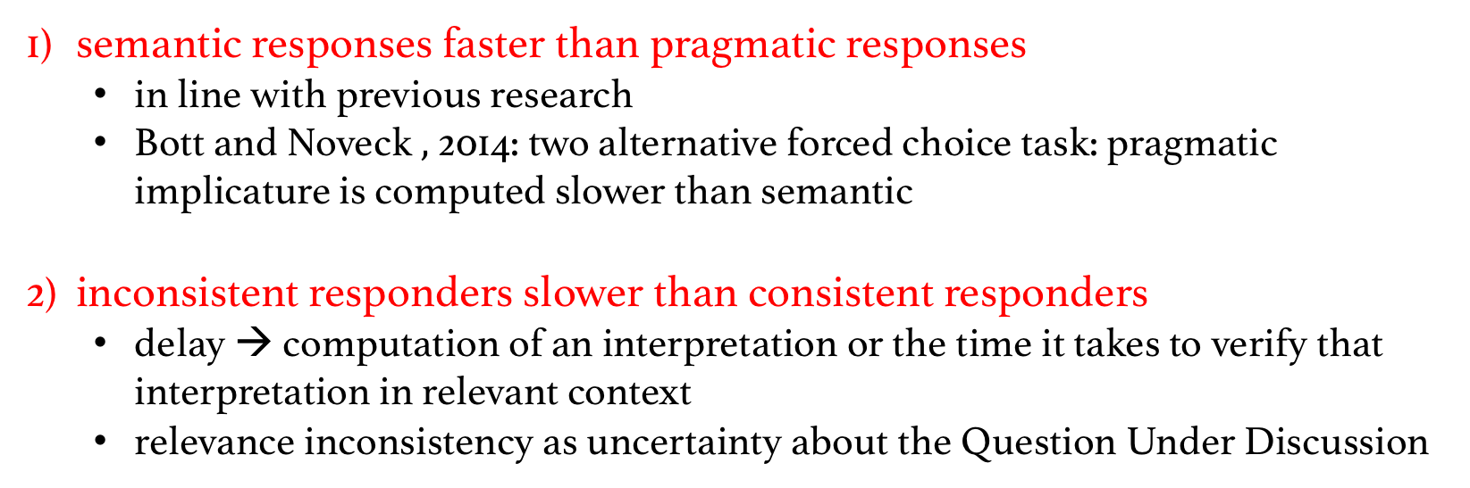
Motivation
Degen 2013 Experiment 2: semantic vs pragmatic processing of the quantifier “some”
semantic responses faster than pragmatic responses
in line with previous research
Bott and Noveck $,$ 2014: two alternative forced choice task: pragmatic implicature is computed slower than semantic
inconsistent responders slower than consistent responders
delay → computation of an interpretation or the time it takes to verify that interpretation in relevant context
relevance inconsistency as uncertainty about the Question Under Discussion
Notes:
The delay might not be caused by the computation of an interpretation, but rather by the time it takes to verify that interpretation in relevant context.

Slide 5
Motivation
Robert 1996, 2004, 2012, 2017: Question Under Discussion
questions that discourse participants are trying to resolve at a given point
example:
(a) Are all of their documents forgeries?
Some of their documents are forgeries.
(b) Is there any evidence against them?
Some of their documents are forgeries.
Not all of their documents are forgeries.
No scalar implicature?
Notes:
QUD is the set of questions which discourse participants are mutually committed to resolving at a given point in time.
The QUD is the question that interlocutors are trying to answer at the point of an utterance.
Previous research shows that scalar implicatures arise only when the stronger alternative is contextually relevant…..
In (a) the scalar implicature, from some to not all arises because the stronger alternative is assumed to be relevant to the QUD in (a) but not to the QUD in (b)
CHANGE – no chalar implicature?

Slide 6
Motivation
“You got some of the gumballs”
Did I get all of the gumballs?
Did I get any of the gumballs?
How many gumballs did I get?
Uncertainty about QUD
Inconsistency results
implicitly establish QUD with cover story
Research Question
Hypothesis
Does the relevance of the stronger alternative to a weak scalar item, manipulated by the implicit QUD, affect the rate of scalar implicatures and the speed of scalar implicature processing?
- Relevance of alternative
- Pragmatic responses
- Speed of pragmatic processing
Notes:
There are many potential QUDs that the utterance “You got some of the gumballs might be interpreted relative to?

Slide 7
Replicated study: manipulating the relevance of the stronger alternative in the gumball paradigm
Cover story:
“You are testing a raw of gumball machines and you tell the store worker whether you agree or disagree with statements. ”
“ Worker will be fired if the machine is empty. ”
Did I get all of the gumballs? → relevant condition
“ Worker will be fired if the machine is jammed and doesn’t deliver gumballs. ”
Did I get none of the gumballs? → less relevant condition
Notes:
In the relevant condition, where the implicit QUD is (a), the stronger alternative “You got all of the gumballs” was highly relevant. In the less relevant condition, where the implicit QUD is (b), the stronger alternative was much less relevant.
Cover story presented to groups of participants to set up an implicit QUD.

Slide 8
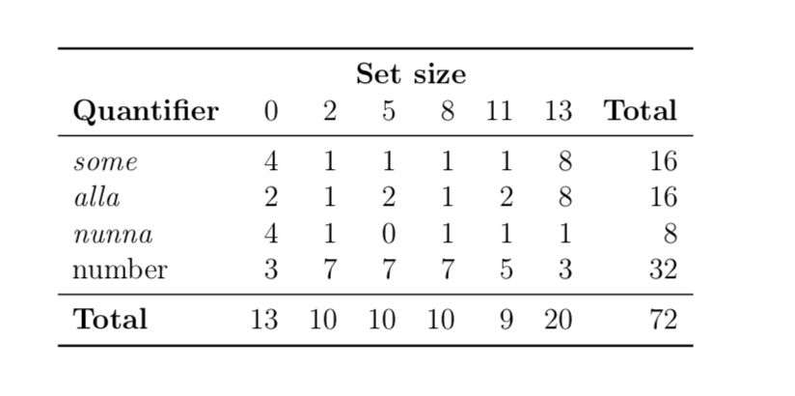
Methods
Participants
Materials
Original study:
Replication:
in lab
57 + 47 undergraduates
Amazon Mechanical Turk
150 participants
all-QUD
29 pt
no-QUD
28 pt
no-QUD
47 pt
all-QUD
50 pt
no-QUD
50 pt
no-QUD
50 pt
exclusions:
1 pt answererd second comprehension questin wrong 5 times
14 pt because of experimentor error
exclusions:
exclusions:
exclusion criteria:
low accuracy: participants with accuracy of lower than 85% on non-critical trials
practice trials: participants who got at least two practice trials wrong
fast workers: participants with logRT>20 in more than 5 trials-
audio: participants who get the audio check wrong more than once
low accuracy
practice trials
fast workers
2
audio
1
2
9
16
6
36 participants excluded
150 - 36 = 114 remaining
Notes:
Between subjects design - each participant is assigned to one of the three conditions and sees a cover story that sets up an implicit QUD (relevant QUD or less relevant QUD) or no QUD

Slide 9
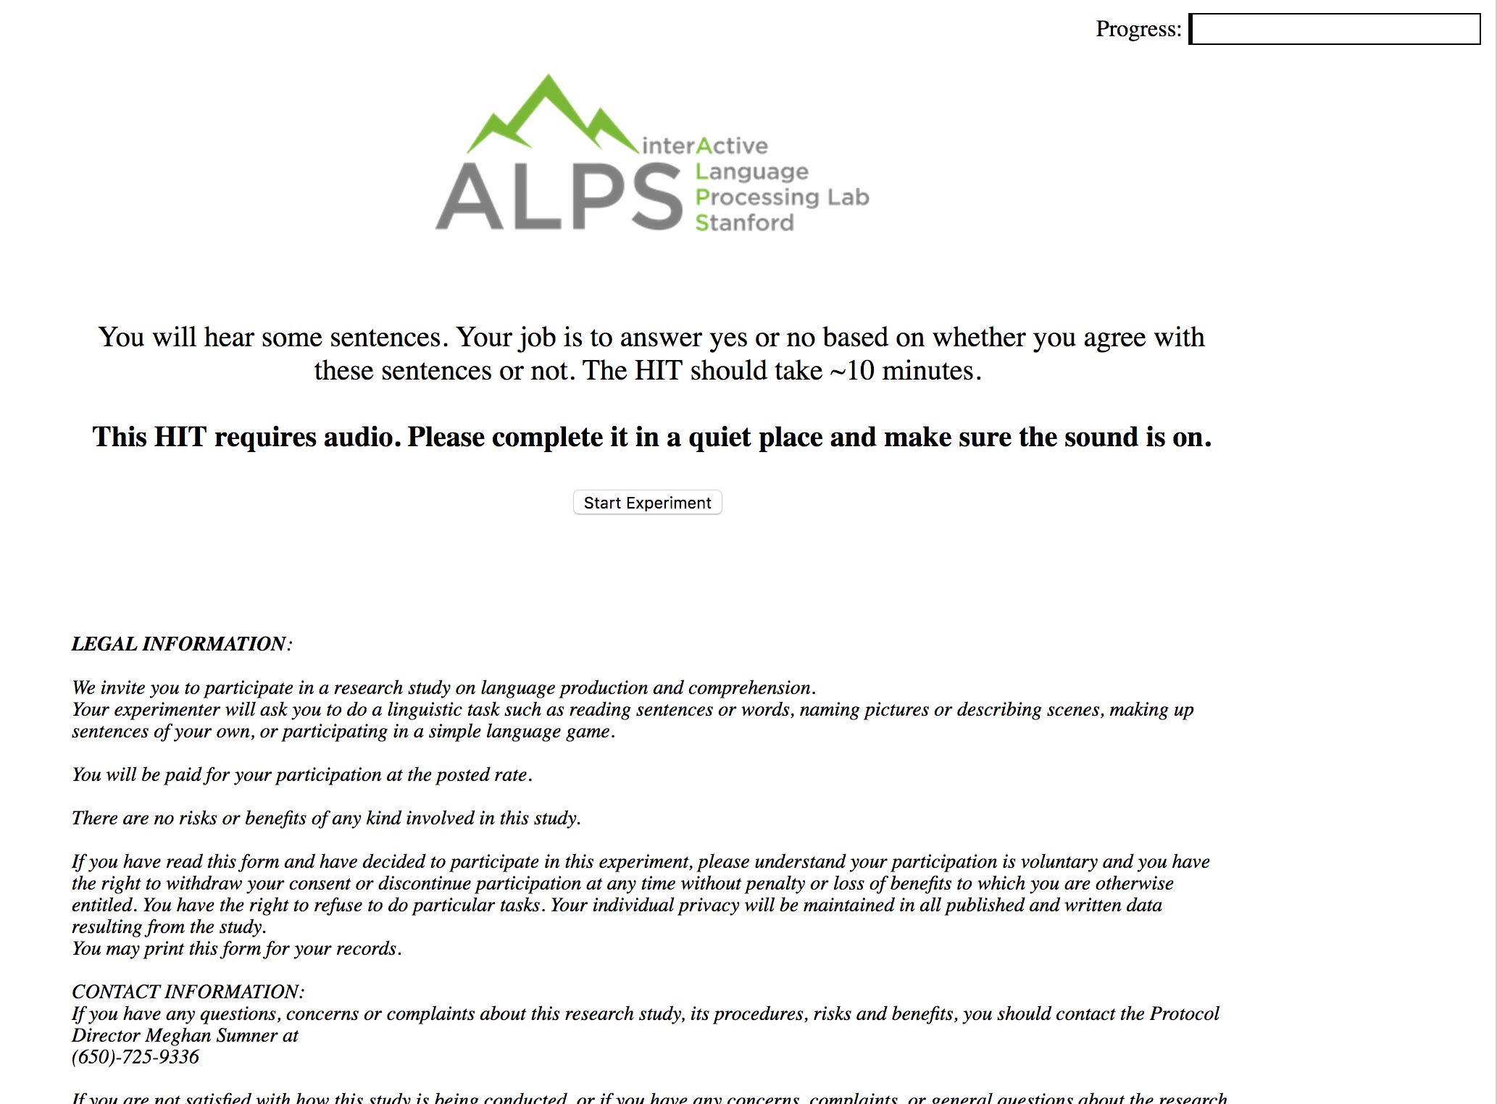
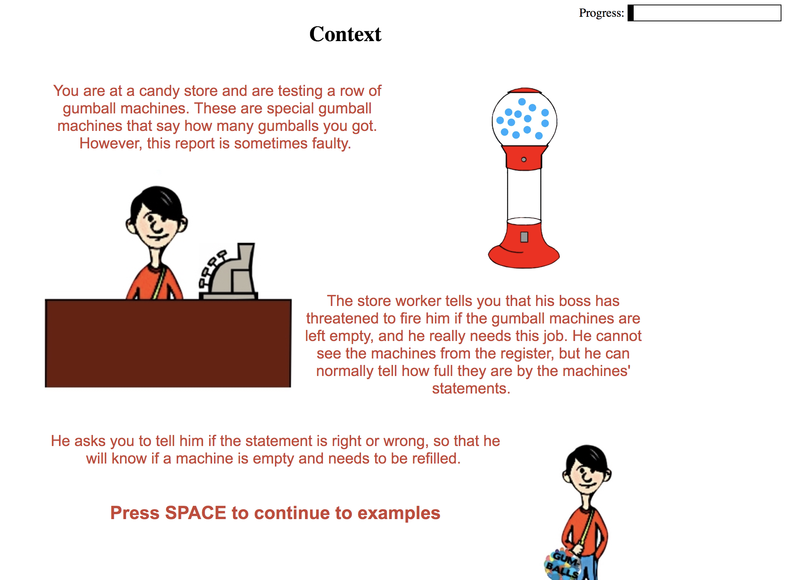
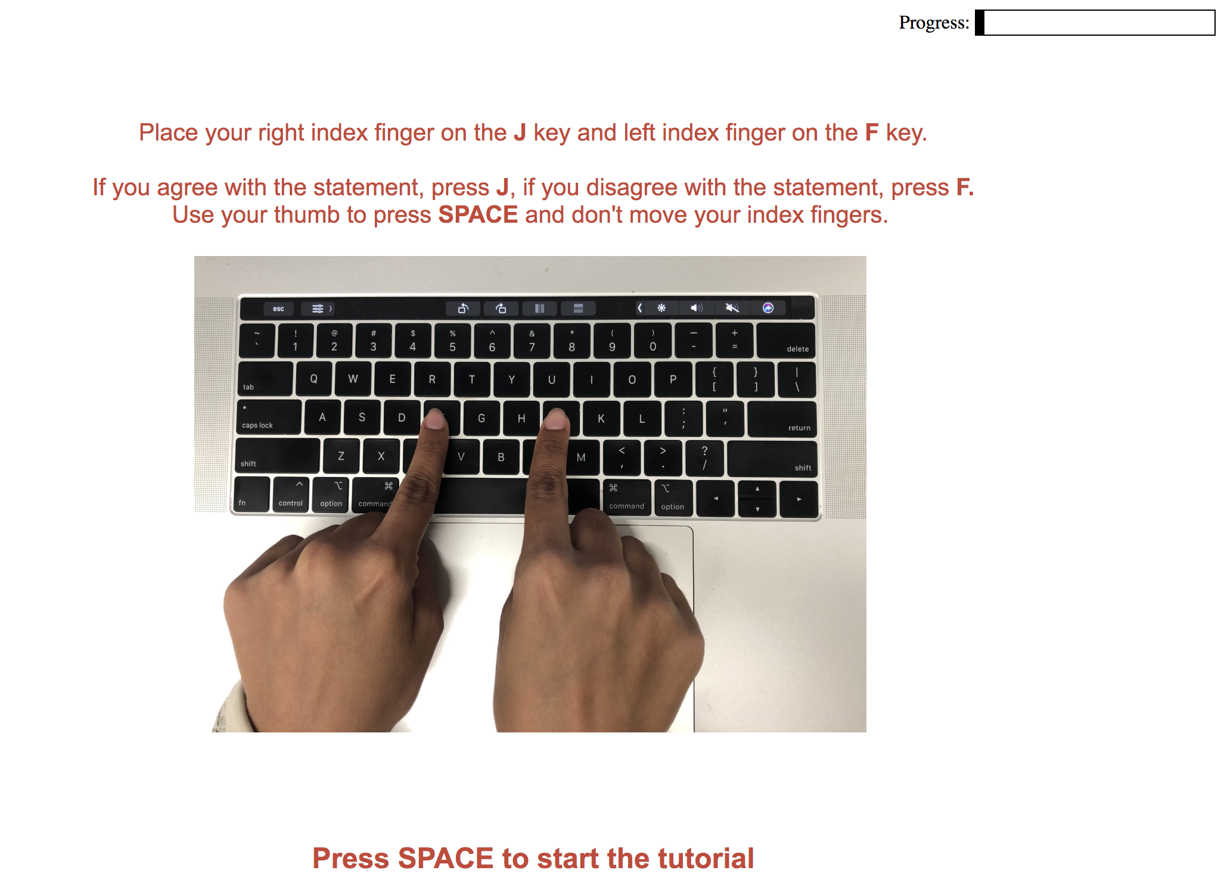
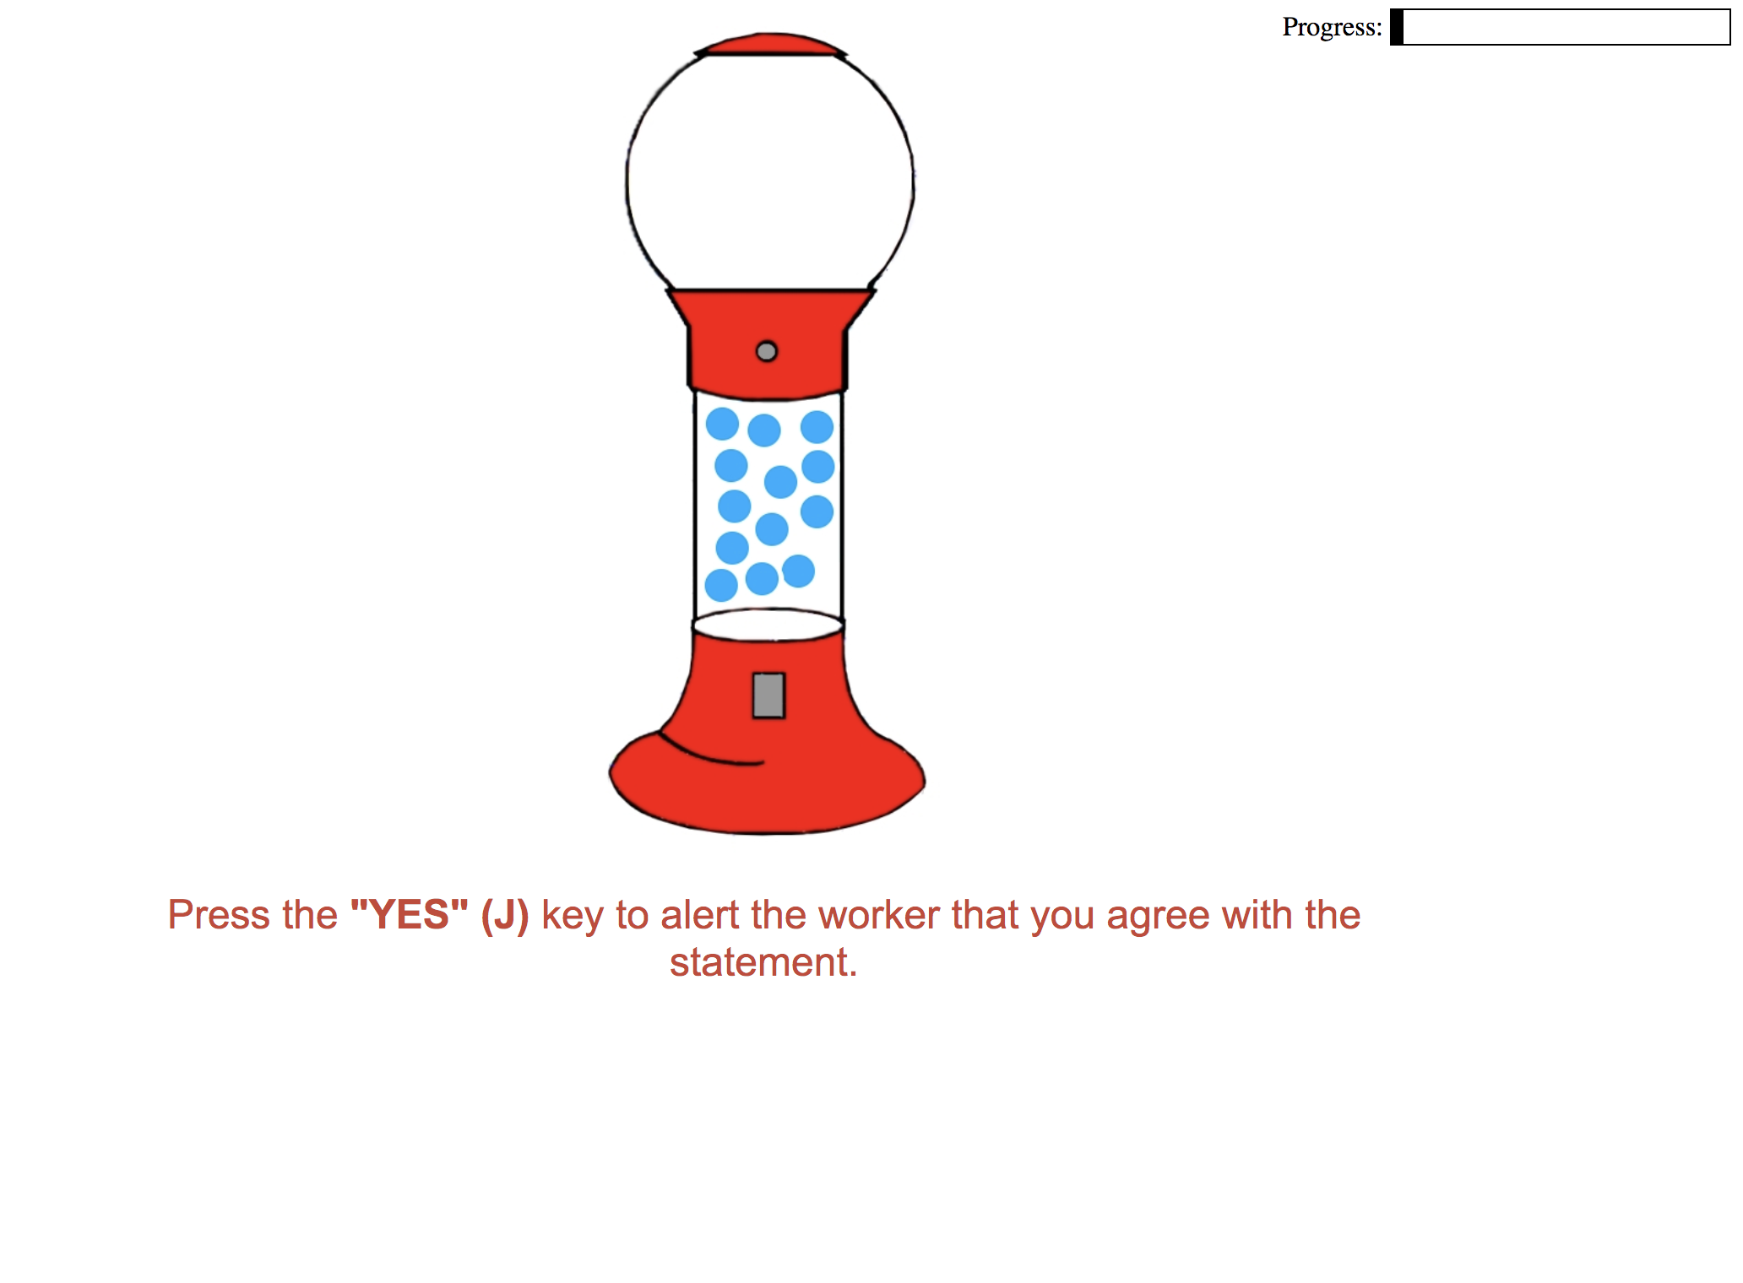
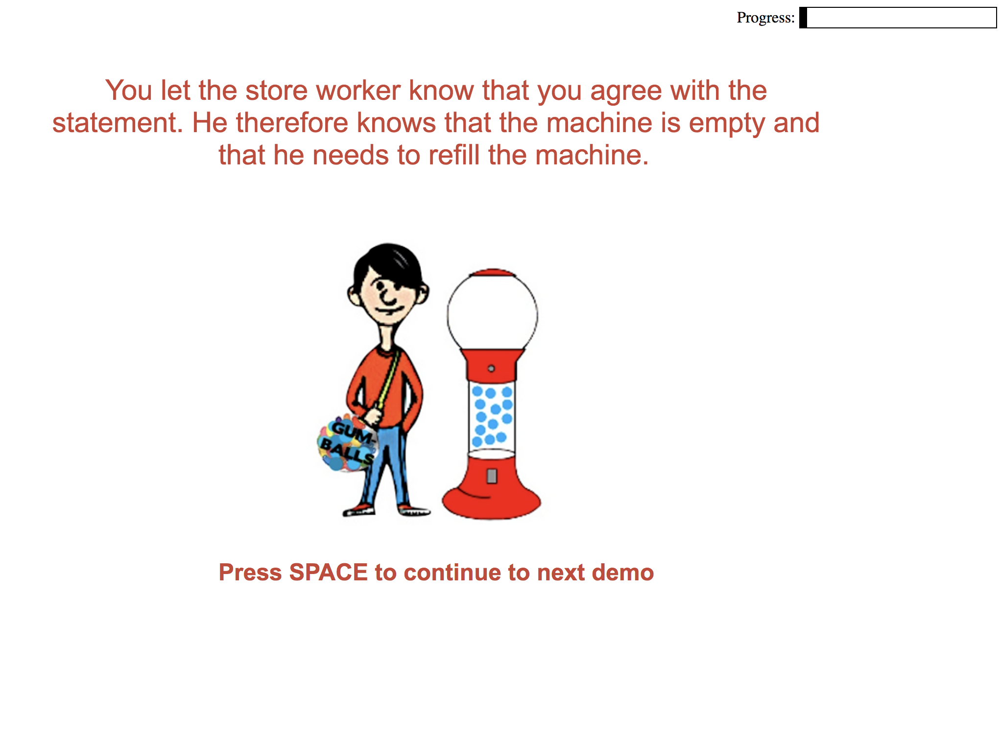
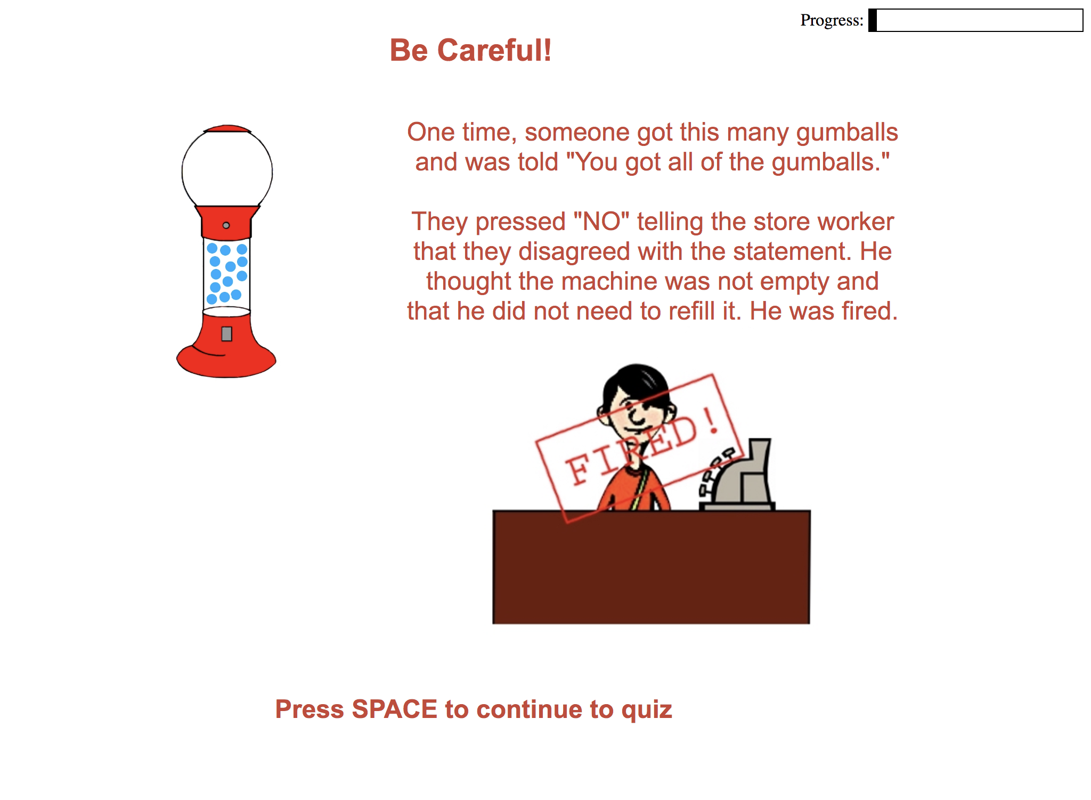
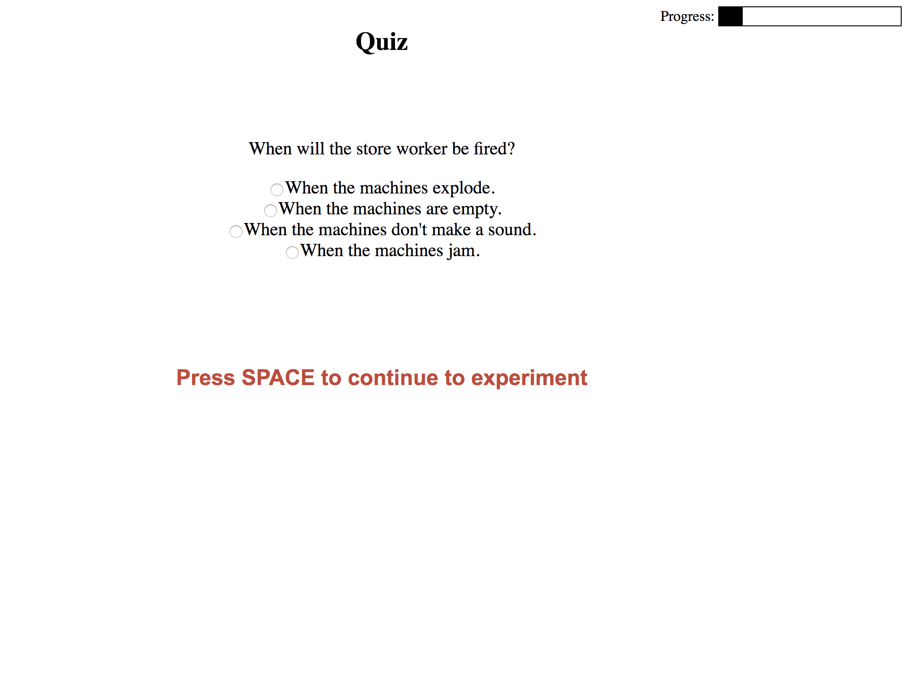
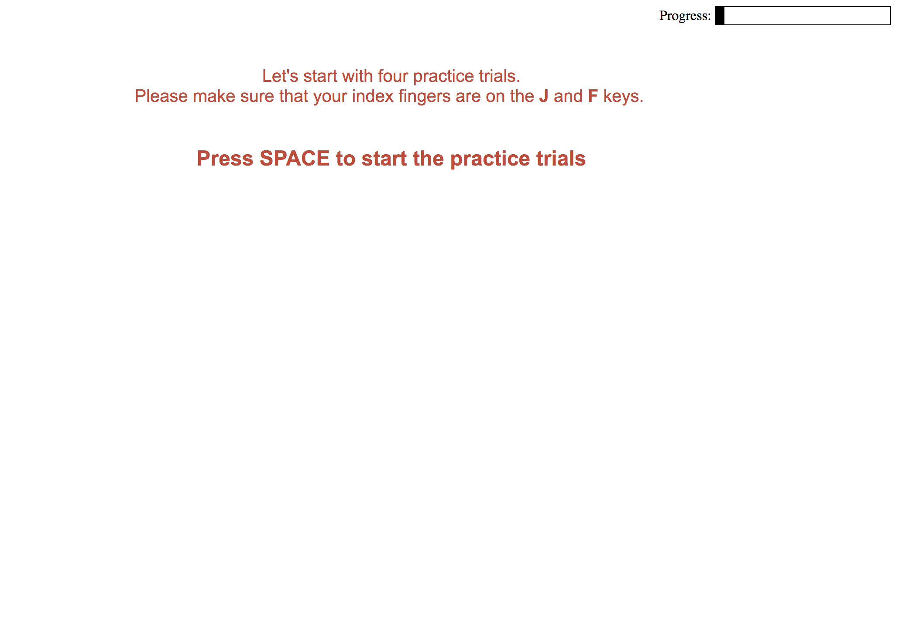
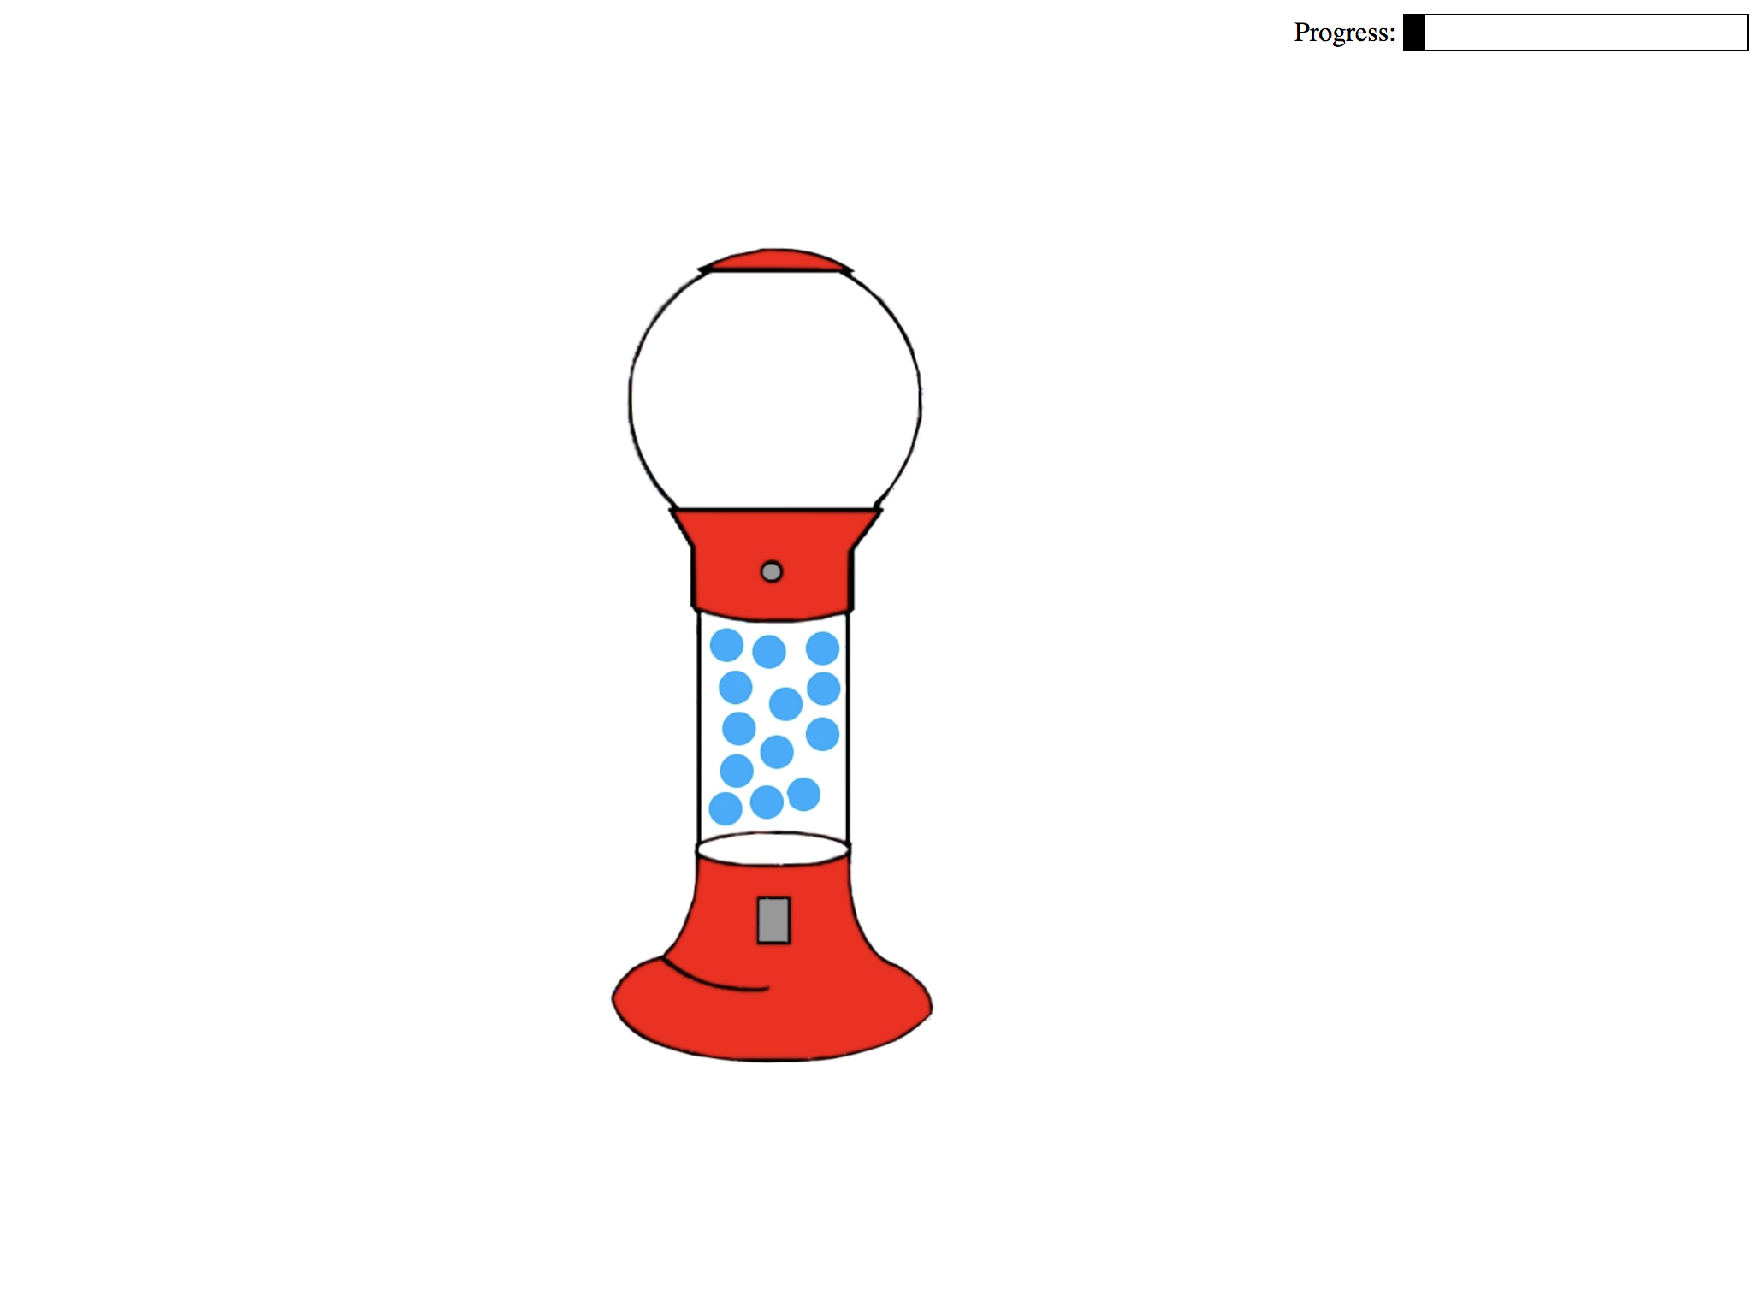
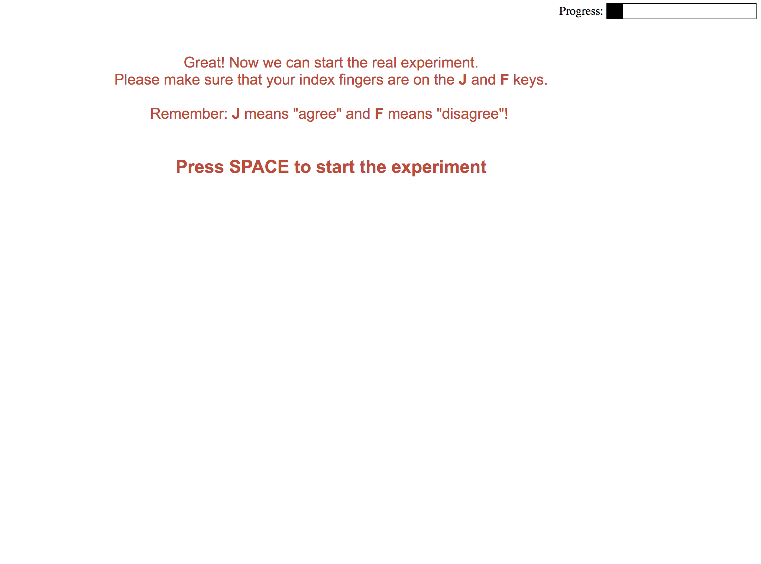

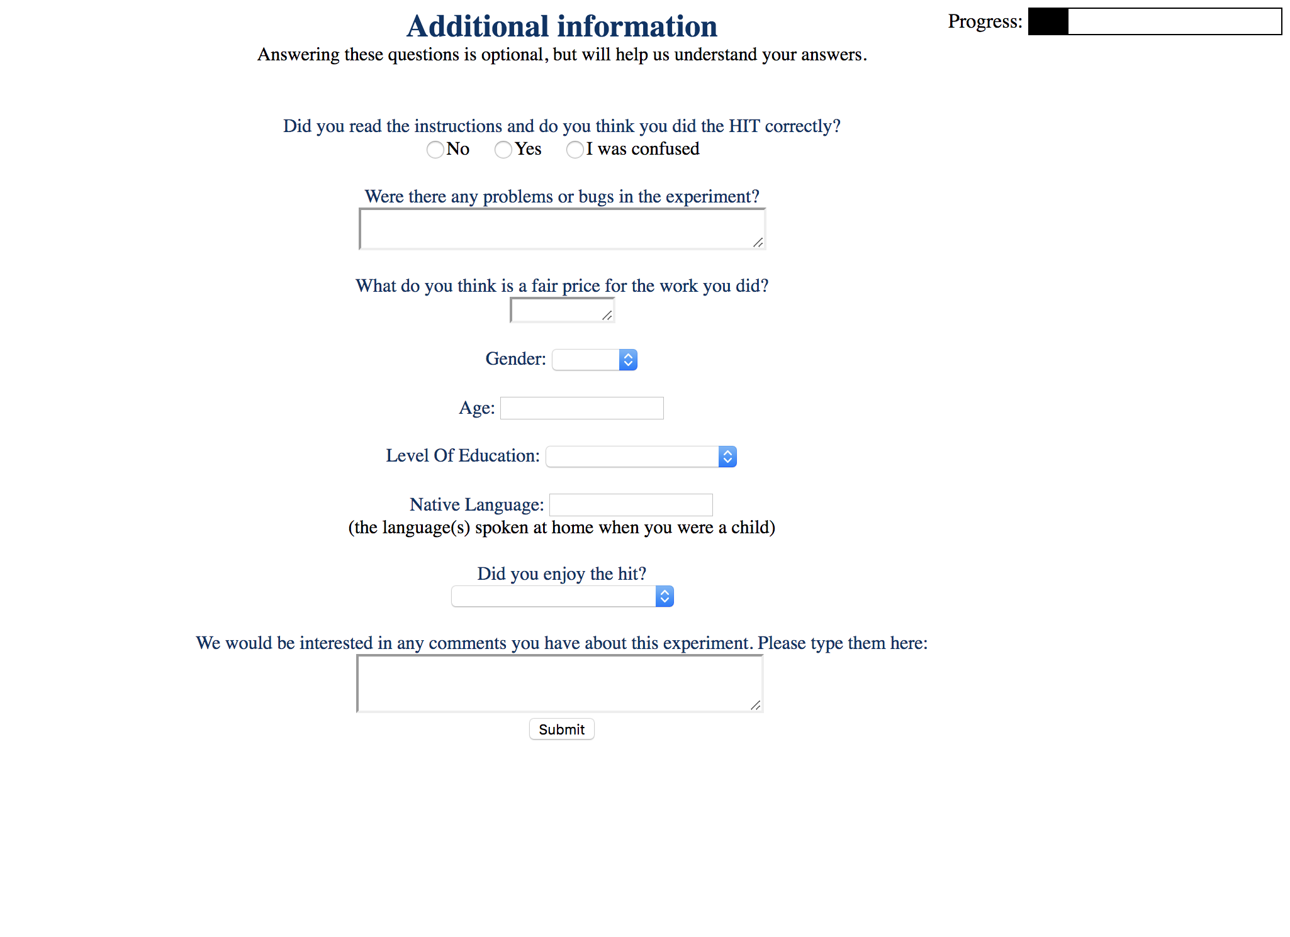
Design
cover story
instructions
demonstration
comprehension test
practice trials x4
experimental trials x32
comprehension test #2
demographic info
experimental trials x32

Slide 10



Critical Trials (8)
If you agree with the statement, press J, if you disagree with the statement, press F.
Notes:
Pragmatic interpretation: You got some, but not all of the gumballs/
\

Slide 11
Critical Trials (8)
If you agree with the statement, press J, if you disagree with the statement, press F.
PRAGMATIC INTERPRETATION
SEMANTIC INTERPRETATION
114 participants x 8 critical trials = 912 responses
Notes:
Only the critical condition is of theoretical interest, rest are fillers
Recorded response type and and time!!

Slide 12
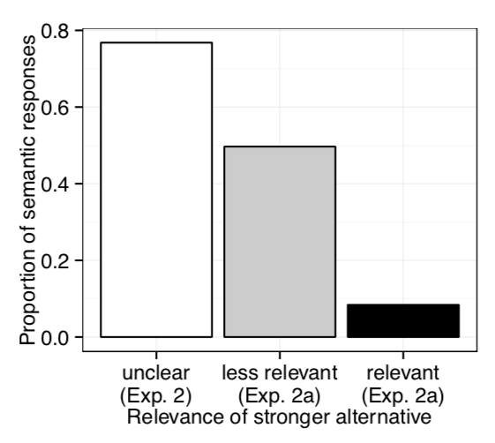
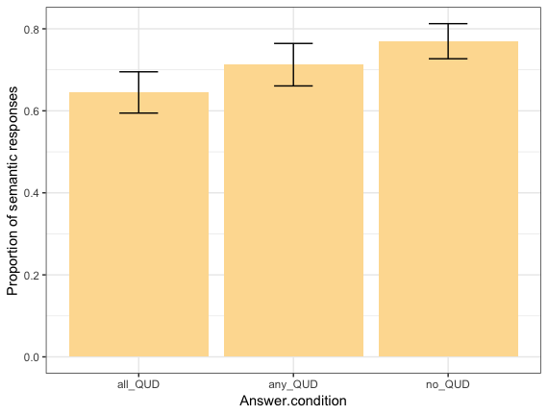
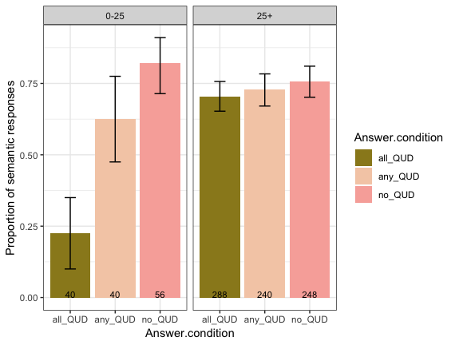
Results: response type
Original experiment:
Replication:
Age effect:
Notes:
You see: proportion of semantic responses in three different conditions, same pattern in each plot
Original:
Mixed effects logistic regression predicting response from fixed effects of QUD revealed main effect of QUD such that there are more pragmatic responses for all-QUD compared to any-QUD and no-QUD
Replication: only with age buckets

Slide 13
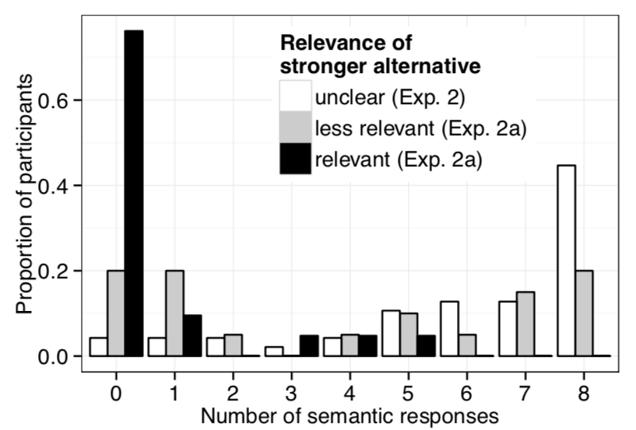
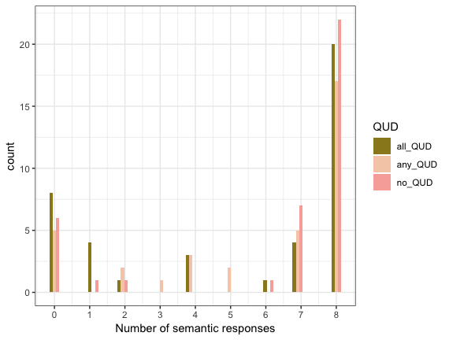
Results: response type
Original experiment:
Replication:

Slide 14
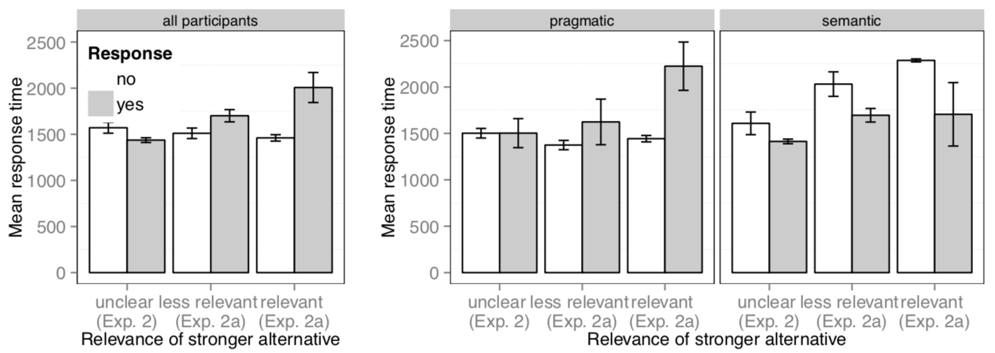
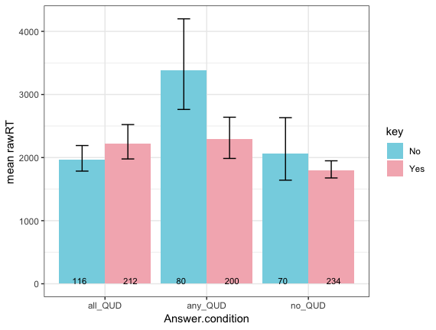
Results: response time
Original experiment:
Age effect:
Replication:
Notes:
Original:
Linear mixed effects regression predicting log response time from fixed effects of QUD, response type and their interaction revealed that
interaction of QUD and response such that the more relevant the alternative, the faster the pragmatic responses become and the slower the semantic responses become.
Also: categorized participants ("semantic" and "pragmatic" responders), use responder type as an interaction term to above, in order to probe whether interaction between QUD and response is mediated by responder type.

Slide 15
Results: response time
More age effect:

Slide 16
Methods
Participants
Materials
Original study:
Replication:
in lab
57 + 47 undergraduates
Amazon Mechanical Turk
150 participants
all-QUD
29 pt
no-QUD
28 pt
no-QUD
47 pt
all-QUD
50 pt
no-QUD
50 pt
no-QUD
50 pt
exclusions:
1 pt answererd second comprehension questin wrong 5 times
14 pt because of experimentor error
exclusions:
exclusions:
exclusion criteria:
low accuracy: participants with accuracy of lower than 85% on non-critical trials
practice trials: participants who got at least two practice trials wrong
fast workers: participants with logRT>20 in more than 5 trials-
audio: participants who get the audio check wrong more than once
low accuracy
practice trials
fast workers
2
audio
1
2
9
16
6
36 participants excluded
150 - 36 = 114 remaining

Slide 17
Conclusions
pragmatic responses could be as fast as, even faster than semantic responses
by controlling the uncertainty about the QUD
age effect
difference in processing of scalar implicature or attentional resources
effect of top-down knowledge (about relevance of stronger alternative)
Default Model
Literal First Model
Constraint-Based Account: contextual factors like relevance of alternatives effects implicature rates and response times

Slide 18
Future Directions
replicate the age effect with more participants in each age group
time pressure
Original study: Participants were asked to respond as quickly as possible. If they did not respond within four seconds of stimulus onset, the trial timed out and the next trial began.
Replication: Participants weren’t under time pressure
another way to make sure QUD is established/not decayed
truth value judgements? scale?
Linking Hypothesis and Number of Response Options Modulate Inferred Scalar Implicature Rate (Jasbi, Waldon and Degen, 2019)

Slide 19
Thank you!
Notes:
CHANGE:
Graphs: should labels be consistent with original study’s plots?
Include BRMS models? Tables?
More about big conclusions? Accounts? Constrained-based..
More on previous research? Bott & Noveck, 2004; Noveck & Posada, 2003
Less on materials/design/exclusions?
Pratyusha’s thesis!!!
Notes: change to full sentences
For each graph write “You see:…”
Add animations

